Slide 1
Board Game LUDO
A Data Structures and Algorithms Project by:
Rehan Ur Rehman | CT-084 Maha Jameel | CT-055
Muhammad Taqi Haider | CT-092

Slide 2

Introduction to Ludo
Ludo is a Board Game consisting of a setup of Upwards of 4 players.
Each player is responsible for moving and scoring 4 pieces of their Color (team).
The Game is played entirely on the Board.
4 distinct branches for scoring pieces of a specific Color.
A player has “Won” when all pieces are scored.

Slide 3
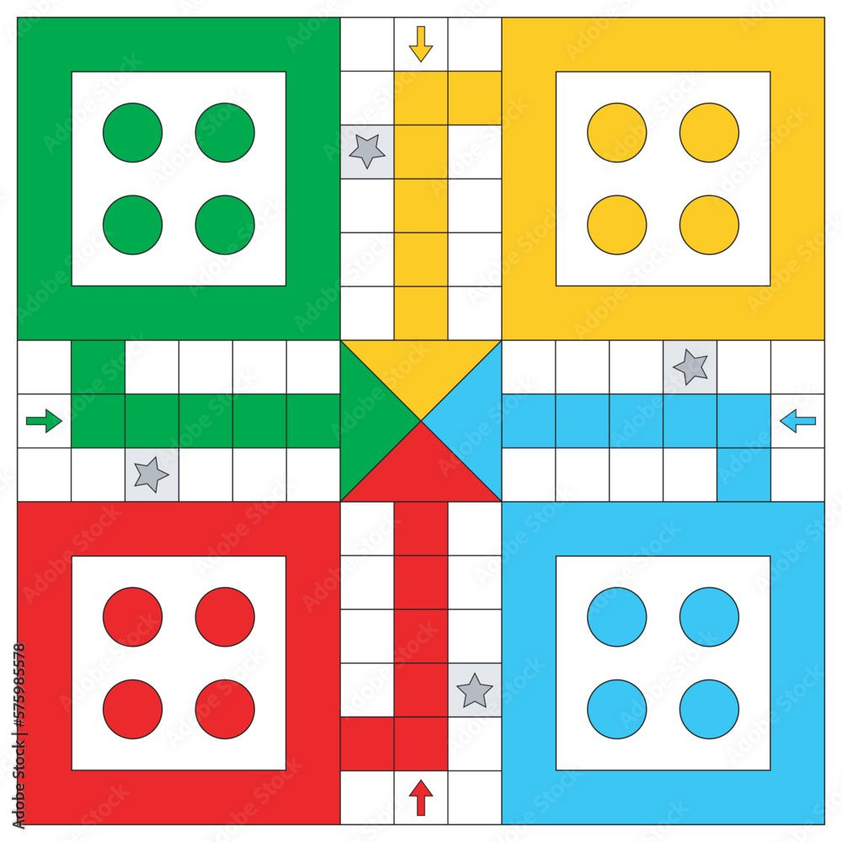
The Board
The Board is a Loop in itself.
It has 4 distinct branches to score each color.
All pieces end on a “Winning / Scoring” square.
Each Piece starts from a “Jail” square and the moves onto the board
There are specific types of “Places” where a piece can move and follow its set of rules.
Hence, The Board is akin to a Singly Circular Linked List, with some added functionality to properly simulate a board
Example Ludo Board from online images

Slide 4
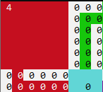
Board Generation
Due to the Board’s rotational Symmetry of Order 4, we will only go through the generation of 1 Quadrant which is repeated 4 times for the entire board.
Firstly a Jail square for a team is assigned (Assume teams are an index)
A sequence of 7 Nodes (to represent places) is generated as steps
A Node is created with captures disabled (the * node)
Followed by 4 Nodes where the 2nd Last node is special as it has 2 different Nodes to point to (i.e Next node, and Home node)
A “Home” line is generated for the next team (team+1) and the special node is assigned its ‘Home’ Node* to that line.
Finally a Start spot for the Next team (team+1) is generated at the end
This is looped 4 times for the whole board
Example Quadrant (Above) Project Quadrant (Below)

Slide 5
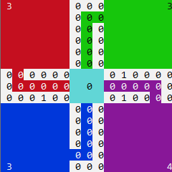
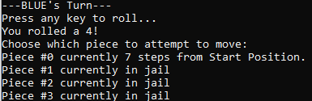
Display
Usage of windows.h for colored display brings some visual issues that are purely cosmetic in behavior.
In the displayed Ludo Board, all “places” (Nodes) have a piece counter shown that represents the total number of pieces on it at that turn. There was no way to represent the color of the piece as well without major complications.
Jails, Starts, and Home Lines are all shown by their respective team colors.
The locations of the pieces of the current player are displayed in text, as a number of steps from their Starting point.

Slide 6
The Player
The Player is autonomous in control of their pieces.
A Player’s turn is Valid under specific conditions which the game can check.
Turns are skipped if no valid moves exists for the player
A turn is dictated by the Number rolled by a Die
This Die - in our project - is a rand()%6 + 1 statement.

Slide 7
Specialized Logics (Player)
For A Player, the specific cases to consider are:
If there 0 valid moves:
If all pieces are immovable (from Piece Logic), then the turn of the player is skipped through checking the states of (canmove and inJail variables of Pieces) where it results in a TRUE statement to skip. Turn increments to next player.
If all pieces have been scored
A check for Playing status is such that
All pieces’ inPlay value is checked
If all of them are FALSE
Change Players Attribute of ‘Playing’ to False (i.e they have finished)

Slide 8
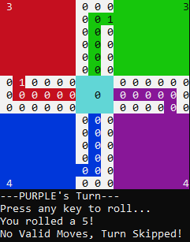
Test Case (Player)
Example: Invalid Turn that needs to be skipped.
In this case, it is Purple’s turn, and they roll a 5.
Results for Move of Piece#1,2,3,4 : Invalid (In jail AND roll != 6)
Since All their pieces are in Jail (shown by the 4 count), none of them have a valid move.
Since piece logic will return invalid move for all pieces here, the Logic for player will read this as a confirmation to skip the player’s turn until next time.

Slide 9
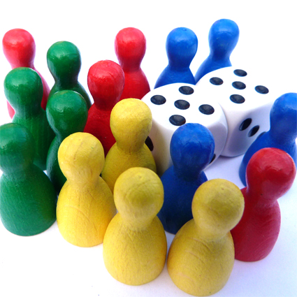
The Pieces
All pieces as, effectively identical markers for the players to keep track of their moves respectively.
Pieces start from their respective Jails, and can be freed by spending a roll of 6 to “free” them to their start spot.
When a piece moves, it moves the number of steps rolled on the die.
If a piece lands on another piece, then the piece (the one that did not move) will be captured.
Captured pieces return to the jail.
Pieces that complete an almost full loop of the board go into their “Home” line instead of repeating another loop
If a piece reaches the end of a home line with no steps to spare, then it is “scored” and is no longer in play.

Slide 10
Specialized Logics (Piece)
For A piece, there are 2 specific cases to consider:
If it moves inside the “Home” line:
If a piece has to move within the home line, and the move rolled is greater than the exact roll needed for scoring (i.e a piece is 2 steps from being scored, but a 3 is rolled) then that move is invalid.
If it has no movable pieces:
A piece is considered immovable under to conditions
The one mentioned above
And if it is in jail and the roll is not equal to 6.
In such case the logic is forwarded to the Player Class to Skip the turn.
If it lands on Another Piece:
The piece landed on gets captured (sent to its jail)
Board is Updated Accordingly

Slide 11
Condition: Opening a Piece
Condition: Moving a Piece
Assume it’s Green Player’s Turn
Assume it’s Yellow Player’s Turn
Initial Board
Initial Board
Die Roll = 6
Die Roll = 2
The Rolled value is 2, The piece will move 2 steps to match its Roll value.
Dry run:
Steps = 0 (no movement)
Steps = 1
(1 space jumped)
Steps < Roll
So,
Steps increments to 2
Steps = Roll is TRUE
Thus, Piece Stops.
Since Rolled value is 6, A piece can be freed from the Jail as shown here.
Piece->Position = Jail
gets changed to
Piece->Position = Start
(where Jail and Start are memory locations)
Final Board
Final Board

Slide 12
Condition: Capture a Piece
Dry Run:
Assume position of blue piece at its Start is #1001 And all places after it are in sequence, 1001,1002,1003,1004…
Therefore the Yellow piece is at #1003
When Blue moves 2 spaces from #1001, it lands on #1003
Therefore since 2 pieces (of different colors) are on the same space, Capture Logic is called
The turn whose turn it is, stays on the position (i.e blue stays on #1003) and the remaining piece gets ‘Captured’ (i.e Moved to its Jail)
Final Board
Initial Board
After, Capturing the Yellow Piece . Blue’s move ends and the yellow piece will move into its jail.
Assume It’s Blue Turn and die value is 2. So it can capture the yellow piece in front of it.

Slide 13
Condition: Piece moves into home lane
Dry Run:
Assume position of red piece is at #1016 And all places after it are in sequence, 1017,1018…
However the Red home lane is at #2001,2002… and so on
When Red moves 2 spaces from #1016, it checks for multiple node* possibilities
Since there are 2 possible routes (one Next, and one for Home)
It Chooses Home if its colors match.
Therefore Red piece moves into its home lane #2002 instead on looping towards #1017,#1018
Final Board
Initial Board
After, Reaching home lane it takes two step inside instead of going to the left.
Assume It’s Red Turn and die value is 2. So it can enter towards it’s home lane.

Slide 14
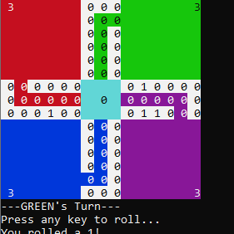
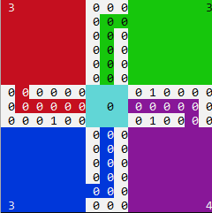
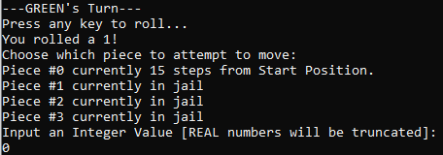
Test Cases (Piece)
Example: Capturing a Piece.
Here, green rolls a 1 which is enough to capture Purple’s piece as it is directly in front of it. (Hard to see since piece specific coloring on board was not possible)
Piece #0 first follows through with its movement. As a result, it lands (i.e ends its movement on Purple’s Piece) and thus captures it.
The piece captured gets returned to jail (see increment in Purple Jail’s count) and its position and inJail values are reset to their starting positions and TRUE respectively.
Example turn of GREEN where it captures a piece.
Original state (left) , Board state after turn (right)

